Slide 1

IoT Smart Home System with AI Decision Making
Ala’aldin Odeh & Mousa Ziadeh

Slide 2
Smart Home Statistics
Global Market
Adoption and Penetration by Country
United States
Revenue projected at $43.0 billion for 2025.
United Kingdom
64% own smart device.
93% of owning smart home device, estimated 54 established systems.
South Korea
Forecasted to have the world's highest penetration rate in the Smart Home Security segment by 2026.
Brazil
Projected to have 27.1 billion total connected devices by the end of 2025.
Advanced systems is projected to reach 68.6% by 2027.

Slide 3
Smart Home Statistics
Global Market
Market Trends and Segments (2025)
Global Household Penetration: Estimated at 77.6% for 2025, with expectations to hit 92.5% by 2029.
Primary Drivers: Security and home automation sub-segments dominate, holding a 41.3% market share.
Dominant Technologies: Wi-Fi remains the primary connectivity standard, accounting for over 48.6% of the market share.
Growth Outlook: The global smart home market is projected to grow from roughly $162 billion in 2025 to over $1.4 trillion by 2034.
https://www.statista.com/outlook/cmo/smart-home/worldwide

Slide 4
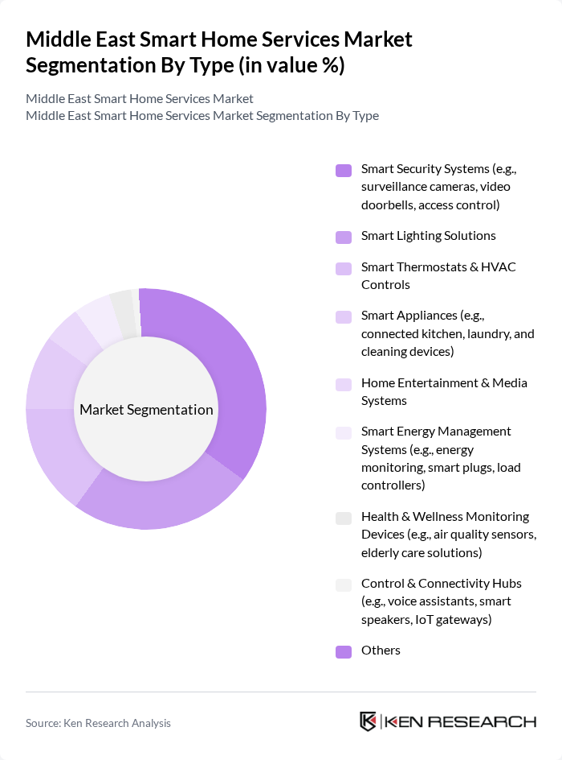
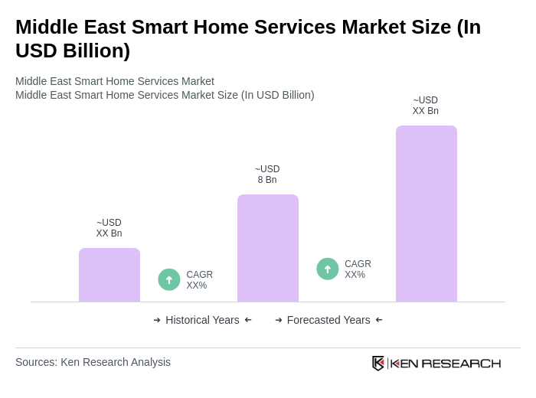
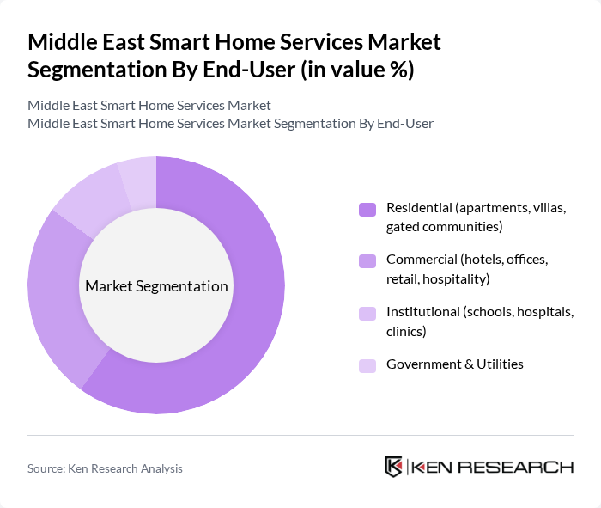
Smart Home Statistics
Middle East
https://www.kenresearch.com/middle-east-smart-home-services-market
Notes:
The Middle East Smart Home Services Market is valued at USD 8 billion, based on a five-year historical analysis. This growth is primarily driven by increasing urbanization, rising disposable incomes, and a growing demand for energy-efficient solutions. The integration of advanced technologies such as IoT and AI into home automation systems has further propelled market expansion, as consumers seek enhanced convenience and security in their living environments .
Key players in this market include the UAE and Saudi Arabia, which dominate due to their rapid technological advancements and high consumer spending on smart home technologies. The UAE, in particular, has established itself as a hub for innovation and smart city initiatives, while Saudi Arabia's Vision 2030 aims to diversify the economy and promote smart living solutions, driving significant investments in this sector .
By Type:The market is segmented into various types of smart home services, including Smart Security Systems, Smart Lighting Solutions, Smart Thermostats & HVAC Controls, Smart Appliances, Home Entertainment & Media Systems, Smart Energy Management Systems, Health & Wellness Monitoring Devices, Control & Connectivity Hubs, and Others. Among these, Smart Security Systems and Smart Lighting Solutions are particularly prominent due to increasing consumer concerns about safety and energy efficiency .
By End-User:The market is segmented by end-user into Residential, Commercial, Institutional, and Government & Utilities. The Residential segment is the largest, driven by increasing consumer interest in home automation and security solutions. The Commercial segment is also growing, as businesses seek to enhance operational efficiency and customer experience through smart technologies .

Slide 5
Smart Home Statistics
Middle East – Growth Drivers
Increasing Consumer Demand for Home Automation.
Rising Awareness of Energy Efficiency.
Technological Advancements in IoT.
Notes:
Increasing Consumer Demand for Home Automation:The Middle East has witnessed a surge in consumer interest in home automation, with the market expected to reach approximately 1.8 million smart home installations in future. This growth is driven by a rising middle class, which is projected to increase by 4 million households in the region, leading to greater disposable income and a willingness to invest in smart technologies that enhance convenience and lifestyle.
Rising Awareness of Energy Efficiency:Energy efficiency is becoming a priority in the Middle East, where energy consumption is projected to rise by 5% annually. Government initiatives, such as the UAE's Energy Strategy 2050, aim to reduce energy consumption by 40%. This has led to increased adoption of smart home technologies that optimize energy use, with an estimated 35% of consumers actively seeking energy-efficient solutions for their homes in future.
Technological Advancements in IoT:The Internet of Things (IoT) is revolutionizing the smart home landscape in the Middle East, with an expected 30 billion connected devices globally in future. Local investments in IoT infrastructure are projected to exceed $1.5 billion, facilitating the integration of smart devices. This technological evolution is enhancing user experience and driving demand for interconnected home systems, making them more accessible and appealing to consumers.

Slide 6
Smart Home Statistics
Middle East – Main Challenges
High initial investment costs.
Lack of standardization in Smart Home Devices.
Security & Privacy Concerns
Notes:
High Initial Investment Costs:One of the significant barriers to smart home adoption in the Middle East is the high initial investment required, which can range from $1,200 to $5,500 for comprehensive systems. This upfront cost deters many potential consumers, especially in a region where economic disparities exist. As a result, only 18% of households currently invest in smart home technologies, limiting market penetration and growth.
Lack of Standardization in Smart Home Devices:The absence of universal standards for smart home devices poses a challenge, leading to compatibility issues among products. Currently, over 65% of consumers express concerns about device interoperability, which hampers their willingness to invest in smart home solutions. This lack of standardization can result in fragmented market growth, as consumers hesitate to adopt technologies that may not work seamlessly together.

Slide 7
Main System Features
AI Decision Making
Configurable & Extendable
Real-time Analytics
Monitoring

Slide 8
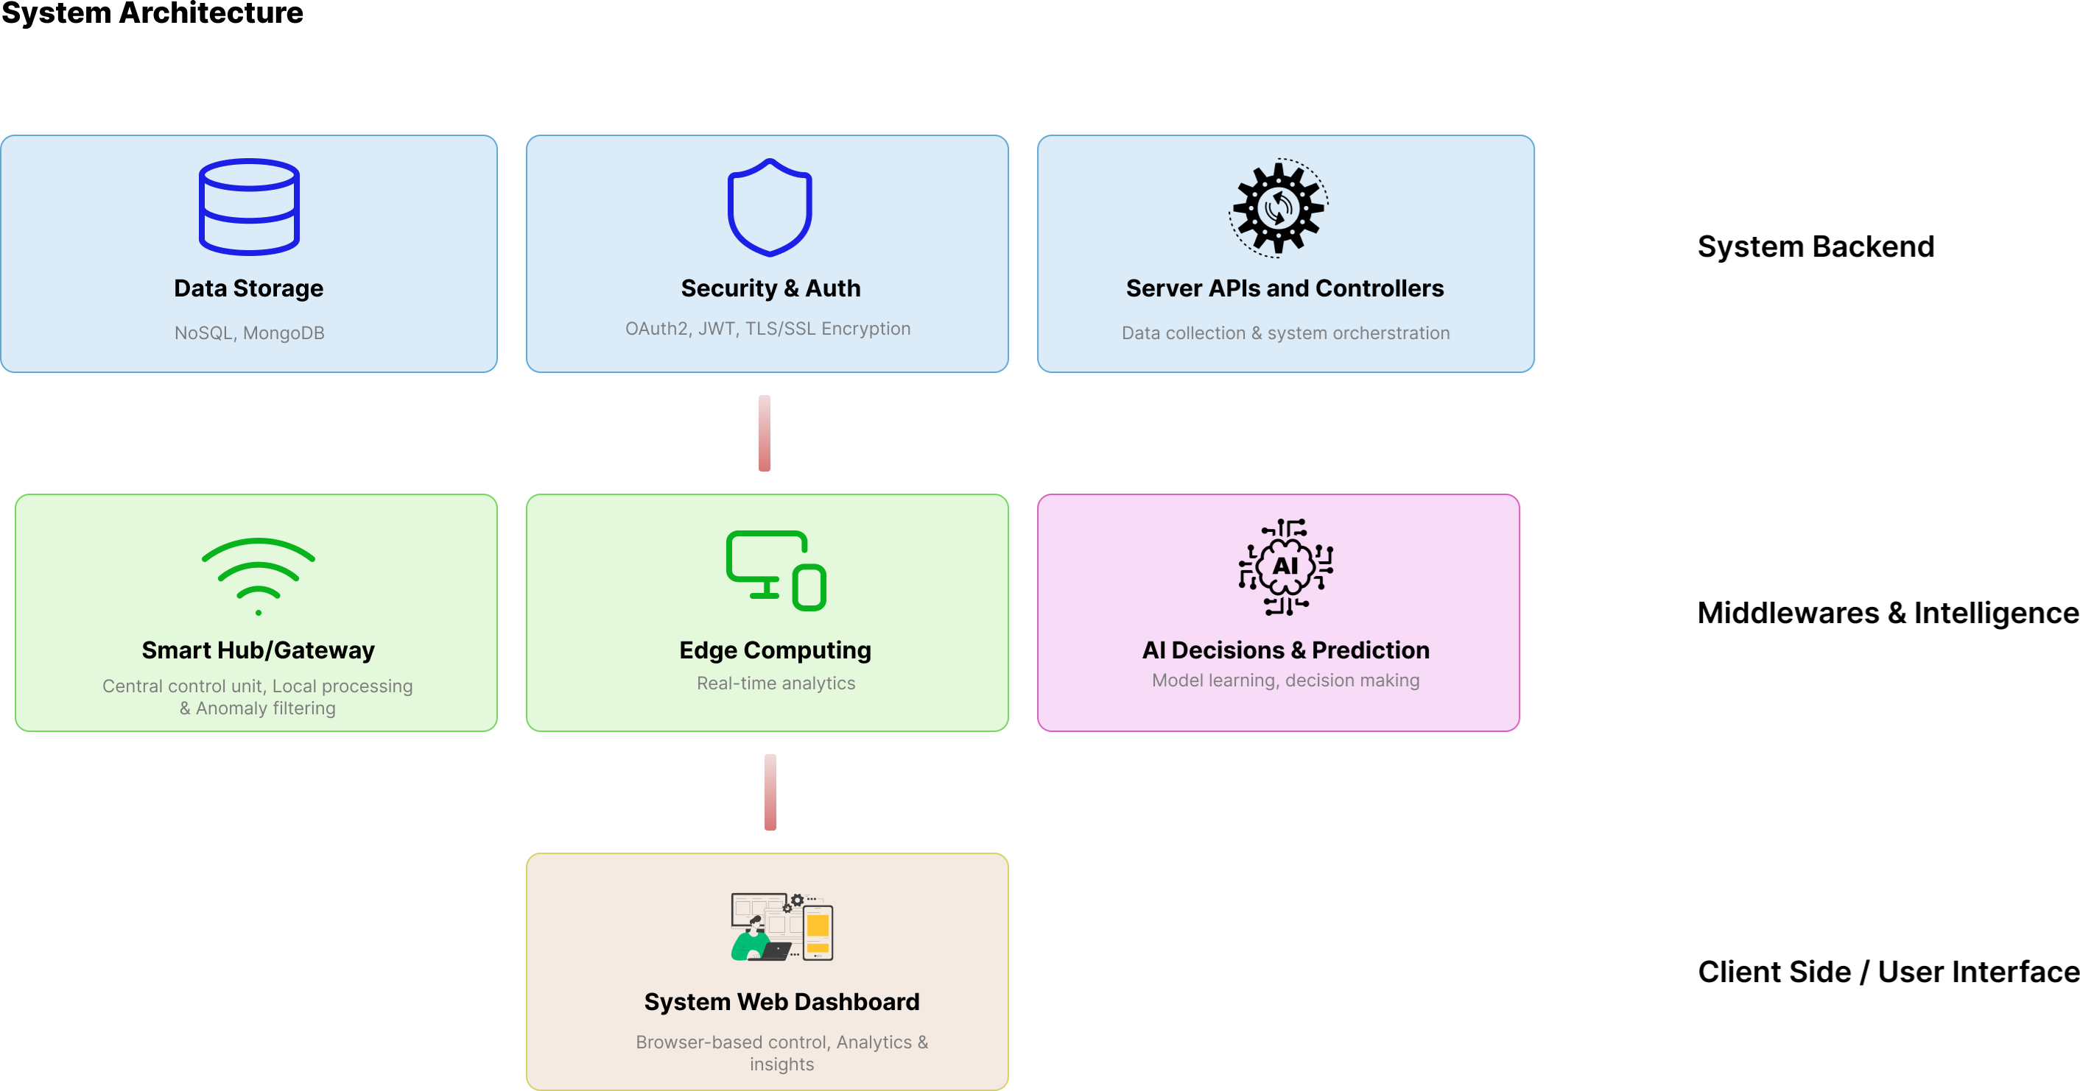
System Architecture

Slide 9
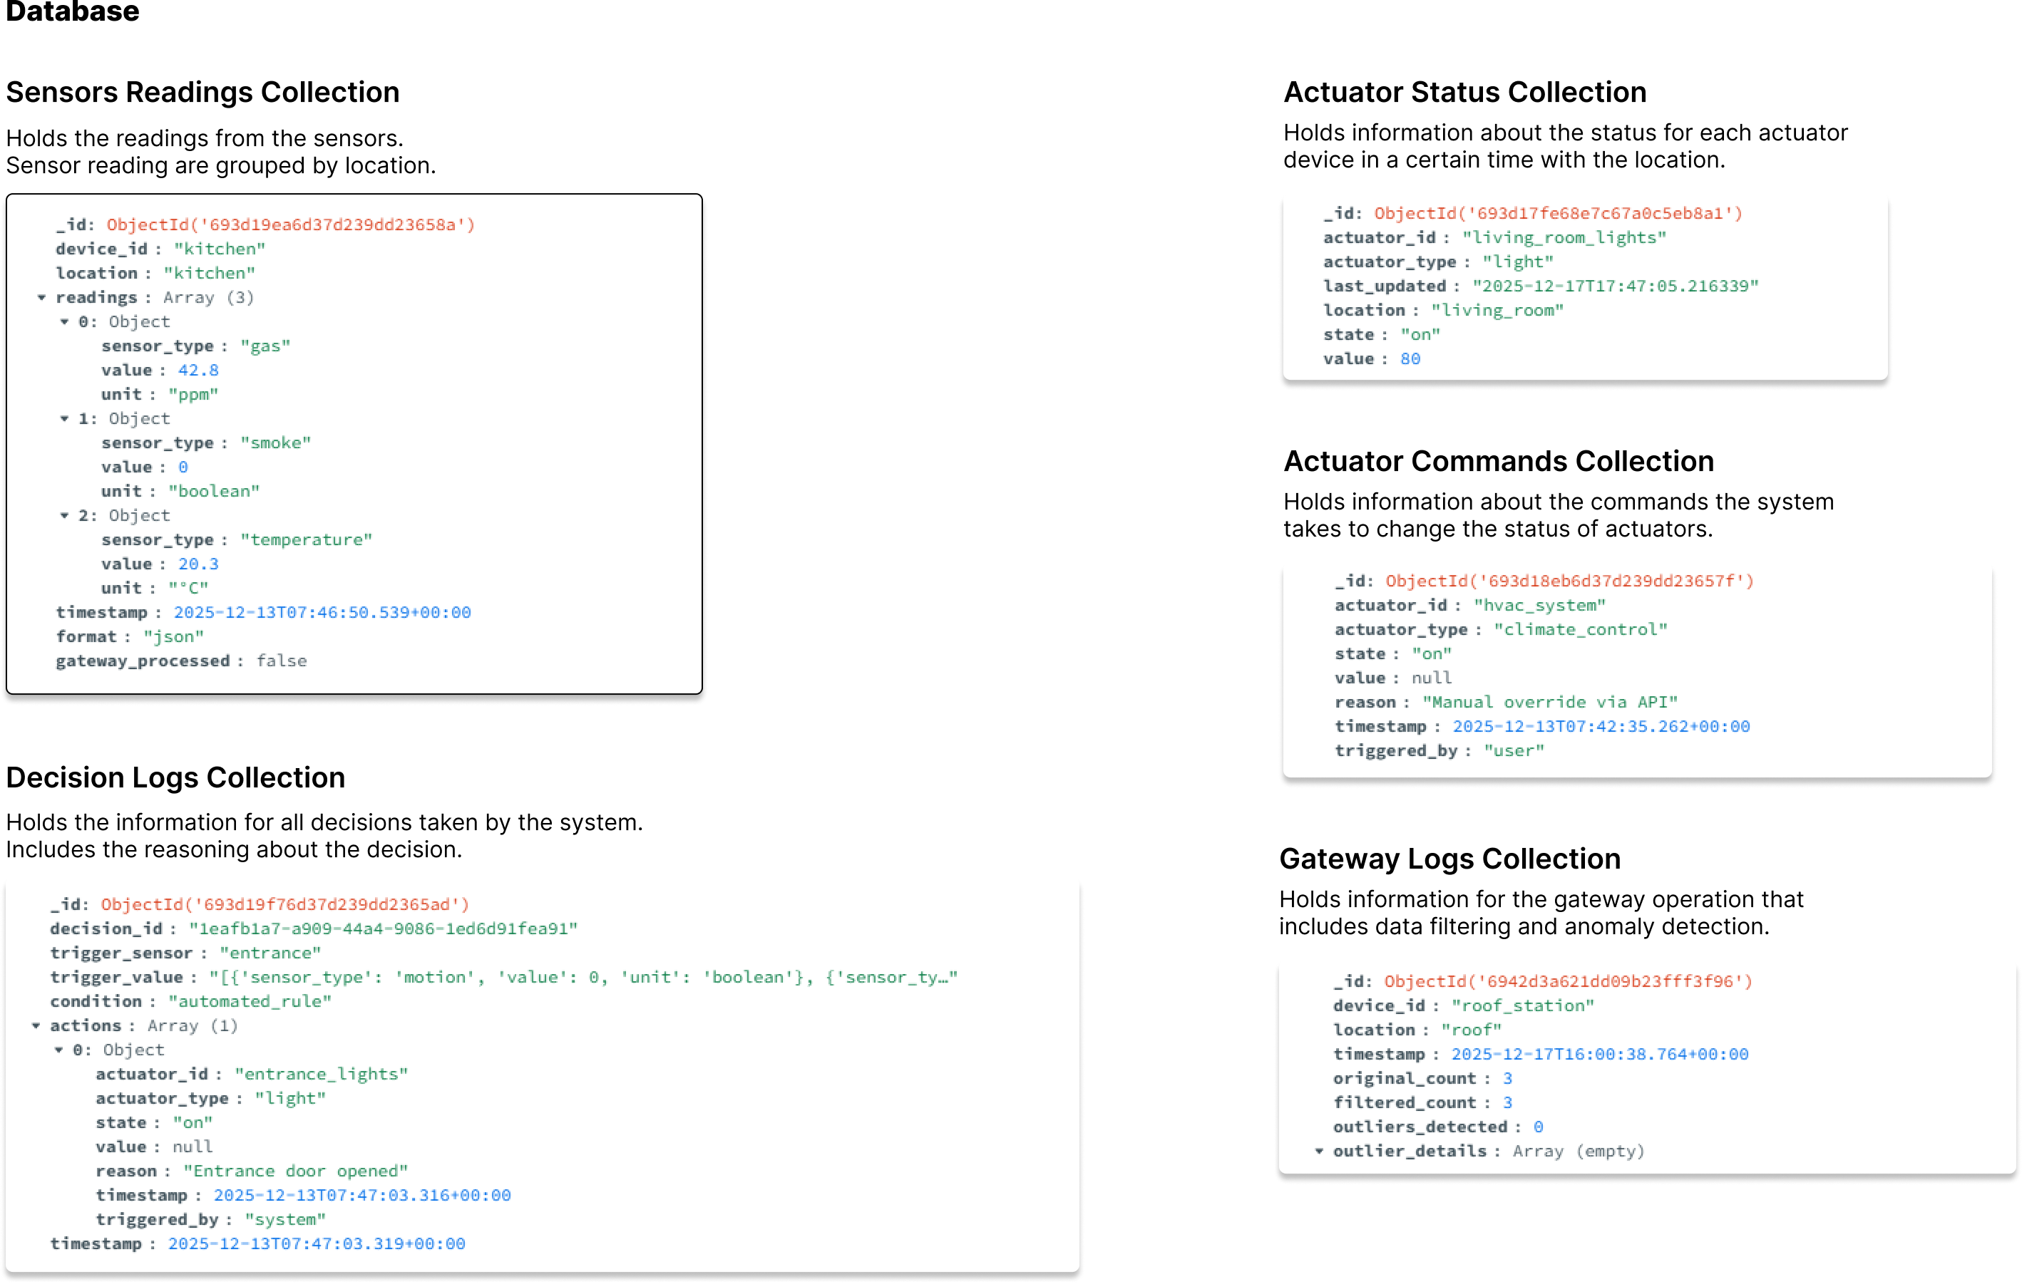
Database Collections

Slide 10
Supported Sensors
Temperature
Humidity
Light
Co2
Motion
Gas
Smoke
Water leak
Sound
Vibration
Energy
UV
Rain
Glass break
Pressure mat

Slide 11
Supported Actuators
HVAC
Room Lights
Kitchen Exhaust
Fire Alarm
Gas Alarm
Door lock
Water Shutoff
Siren
Dust Cleaner
Dehumidifier

Slide 12
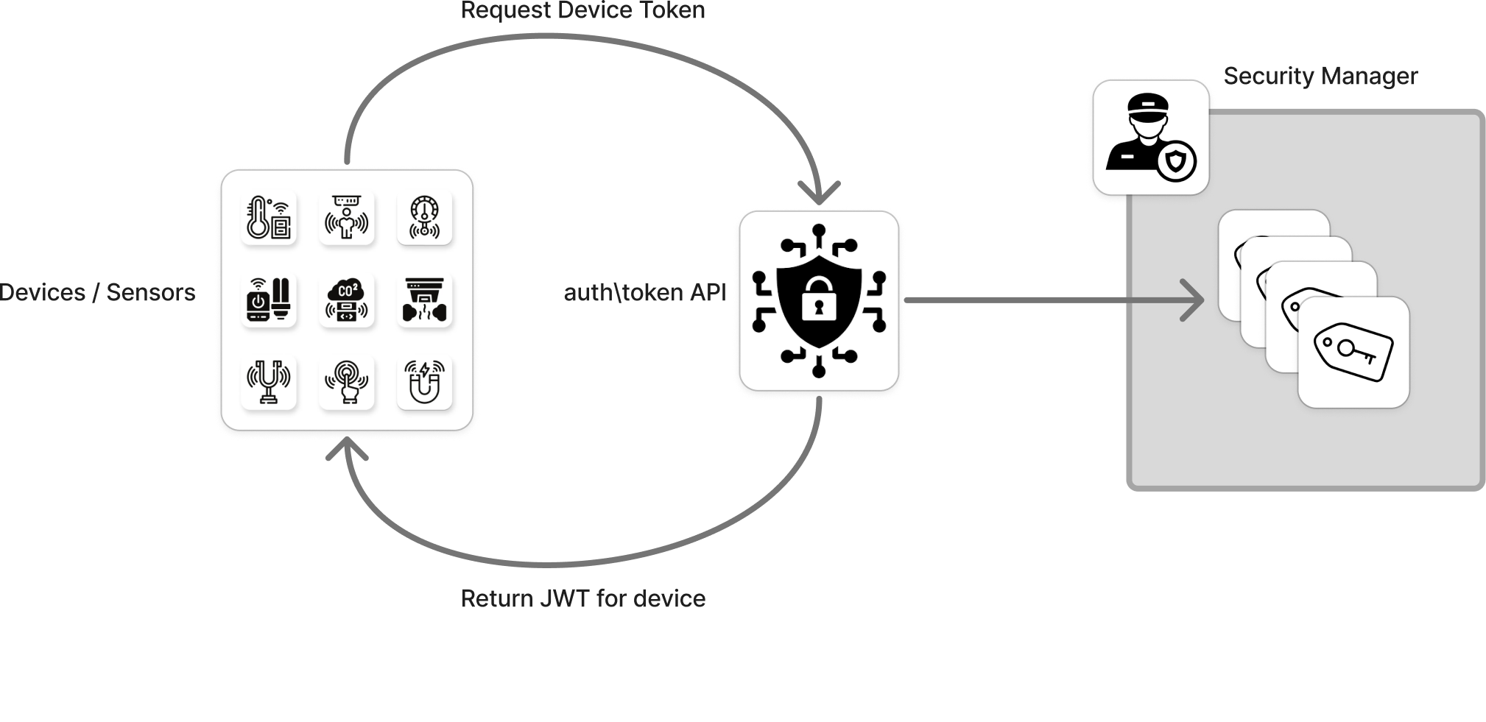
Security – Auth Flow

Slide 13
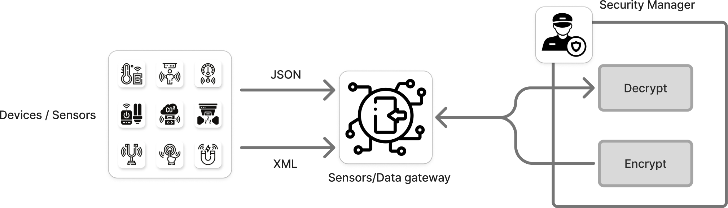
Security – Data Encryption/Decryption

Slide 14
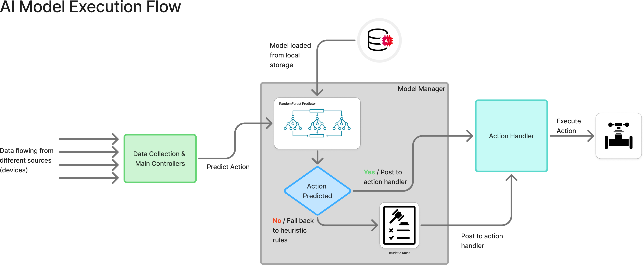
AI Model – Execution Flow

Slide 15
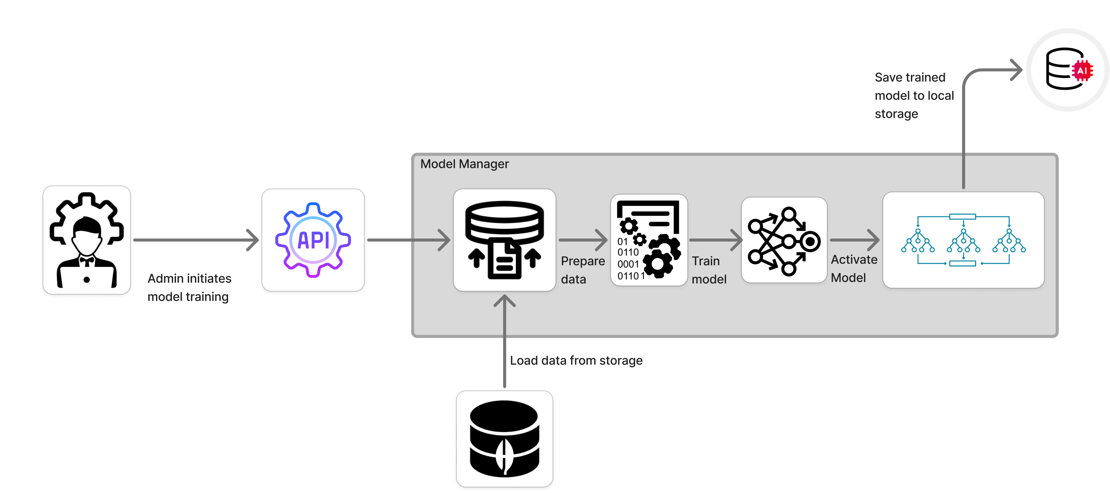
AI Model – Training Flow

Slide 16
Demo

